Slide 1
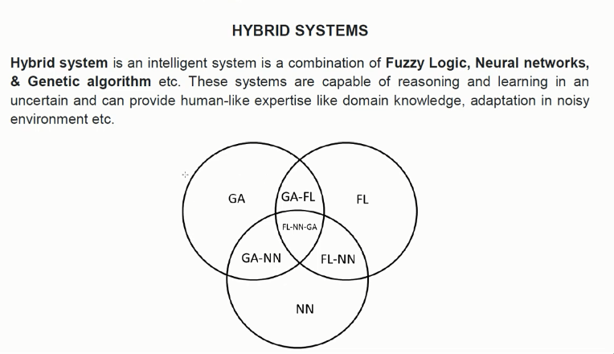
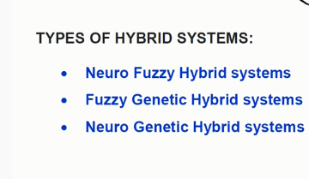

Slide 2
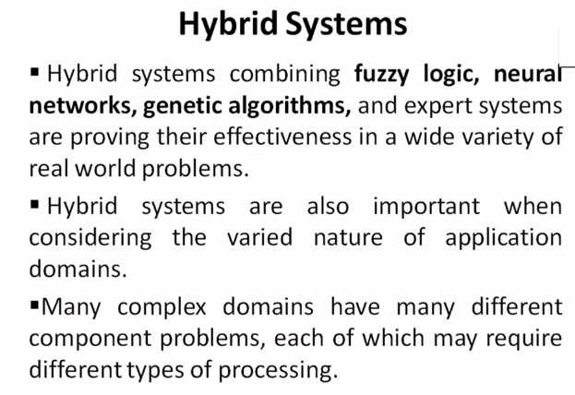

Slide 3
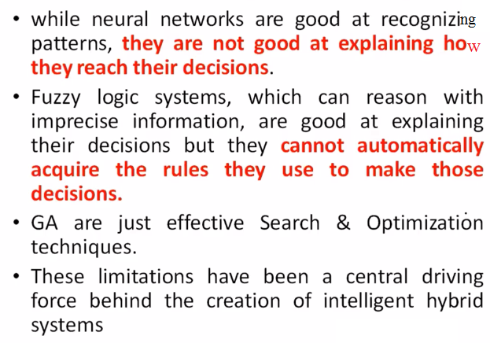

Slide 4
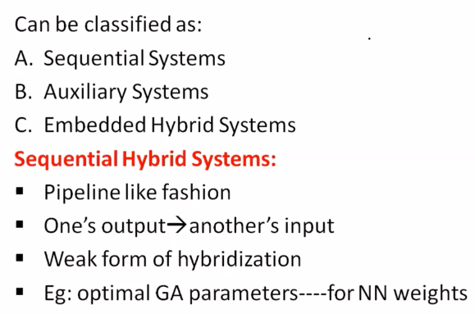

Slide 5
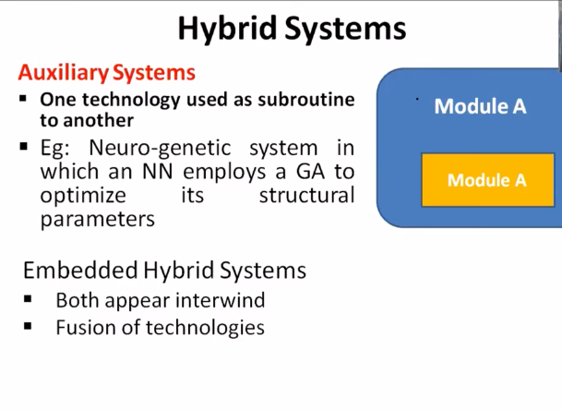

Slide 6
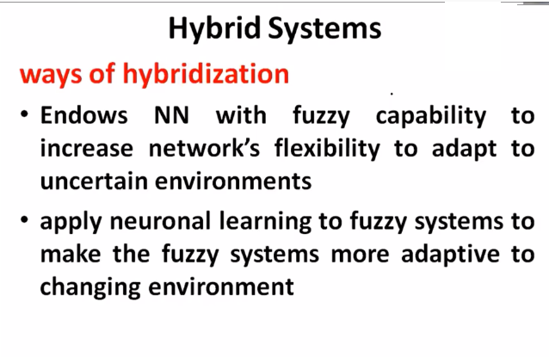

Slide 7
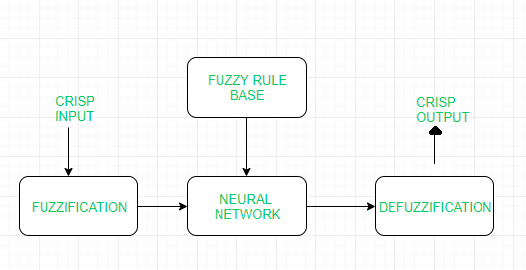
Neuro Fuzzy Hybrid systems:
Neuro fuzzy system is based on fuzzy system which is trained on the basis of working of neural network theory. The learning process operates only on the local information and causes only local changes in the underlying fuzzy system. A neuro-fuzzy system can be seen as a 3-layer feed forward neural network. The first layer represents input variables, the middle (hidden) layer represents fuzzy rules and the third layer represents output variables. Fuzzy sets are encoded as connection weights within the layers of the network, which provides functionality in processing and training the model.

Slide 8
Working flow:
In input layer, each neuron transmits external crisp signals directly to the next layer.
Each fuzzification neuron receives a crisp input and determines the degree to which the input belongs to input fuzzy set.
Fuzzy rule layer receives neurons that represent fuzzy sets.
An output neuron, combines all inputs using fuzzy operation UNION.
Each defuzzification neuron represents single output of neuro-fuzzy system
Advantages:
It can handle numeric, linguistic, logic, etc kind of information.
It can manage imprecise, partial, vague or imperfect information.
It can resolve conflicts by collaboration and aggregation.
It has self-learning, self-organizing and self-tuning capabilities.
It can mimic human decision-making process.

Slide 9
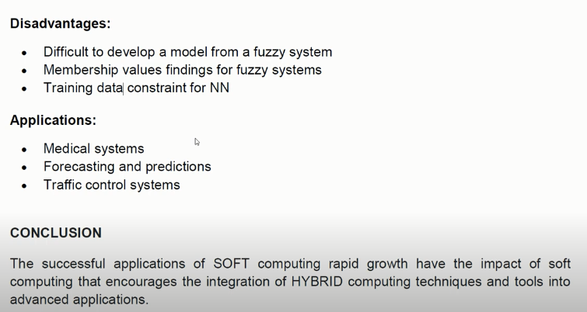

Slide 10
(B) Neuro Genetic Hybrid systems:
A Neuro Genetic hybrid system is a system that combines Neural networks: which are capable to learn various tasks from examples, classify objects and establish relation between them and Genetic algorithm: which serves important search and optimization techniques. Genetic algorithms can be used to improve the performance of Neural Networks and they can be used to decide the connection weights of the inputs. These algorithms can also be used for topology selection and training network.

Slide 11
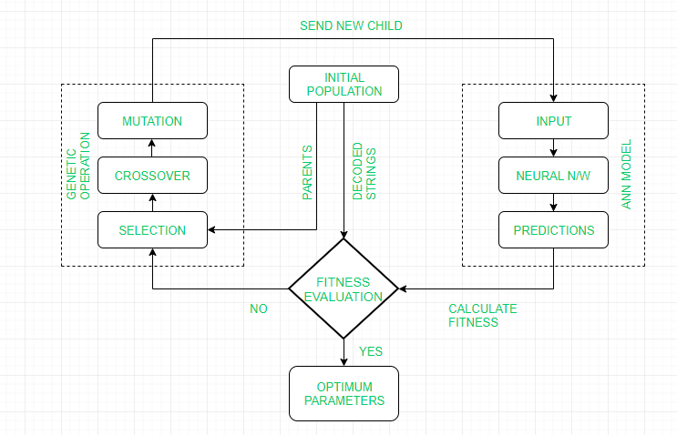

Slide 12
Working Flow:
GA repeatedly modifies a population of individual solutions. GA uses three main types of rules at each step to create the next generation from the current population:
Selection to select the individuals, called parents, that contribute to the population at the next generation
Crossover to combine two parents to form children for the next generation
Mutation to apply random changes to individual parents in order to form children
GA then sends the new child generation to ANN model as new input parameter.
Finally, calculating of the fitness by developed ANN model is performed.

Slide 13
Advantages:
GA is used for topology optimization i.e to select number of hidden layers, number of hidden nodes and interconnection pattern for ANN.
In GAs, the learning of ANN is formulated as a weight optimization problem, usually using the inverse mean squared error as a fitness measure.
Control parameters such as learning rate, momentum rate, tolerance level, etc are also optimized using GA.
It can mimic human decision-making process.

Slide 14
Disadvantages:
Highly complex system.
Accuracy of the system is dependent on the initial population.
Maintenance costs are very high.
Applications:
Face recognition
DNA matching
Animal and human research
Behavioural system

Slide 15
Fuzzy Genetic Hybrid systems:
A Fuzzy Genetic Hybrid System is developed to use fuzzy logic based techniques for improving and modelling Genetic algorithms and vice-versa. Genetic algorithm has proved to be a robust and efficient tool to perform tasks like generation of fuzzy rule base, generation of membership function etc.
Three approaches that can be used to develop such system are:
Michigan Approach
Pittsburgh Approach
IRL Approach

Slide 16
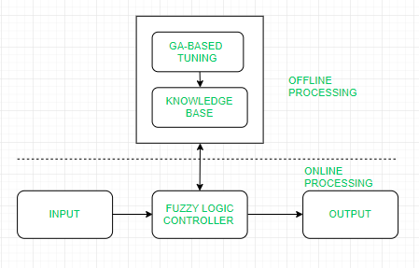
Working Flow:
Start with an initial population of solutions that represent first generation.
Feed each chromosome from the population into the Fuzzy logic controller and compute performance index.
Create new generation using evolution operators till some condition is met.

Slide 17
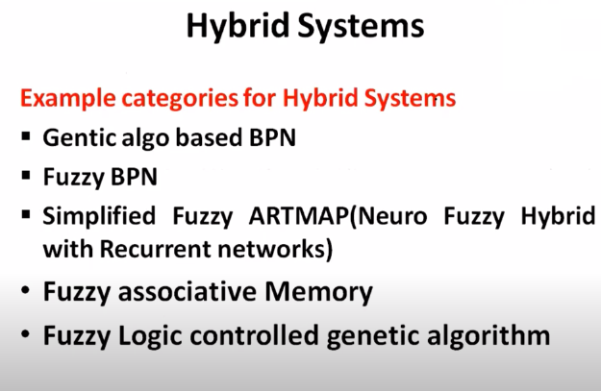

Slide 18
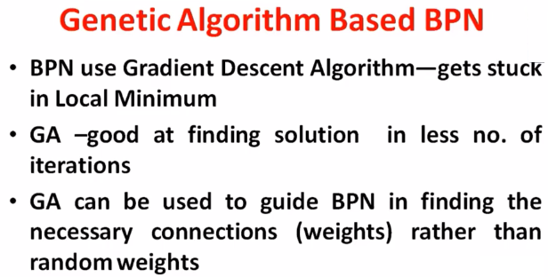

Slide 19
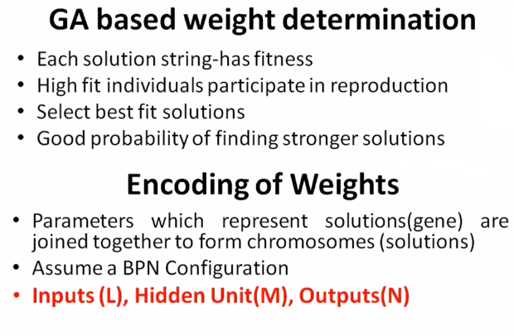

Slide 20
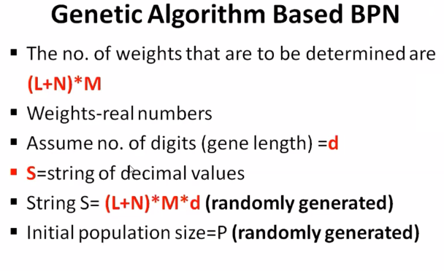

Slide 21
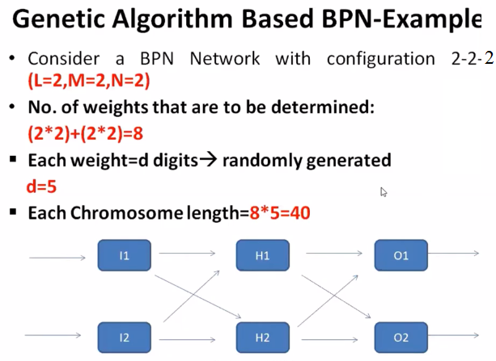

Slide 22
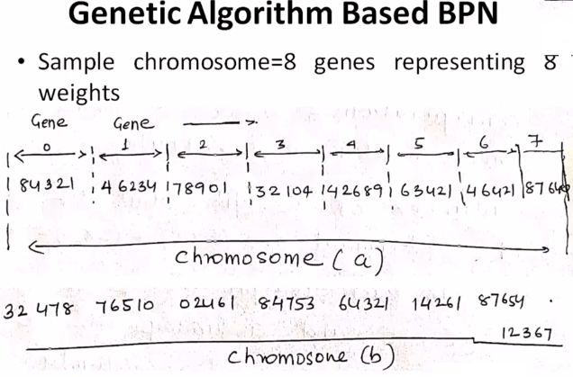

Slide 23
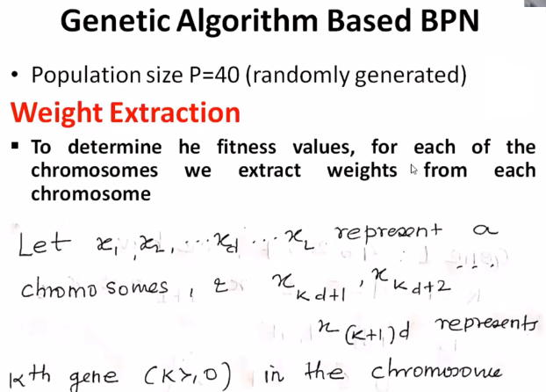

Slide 24
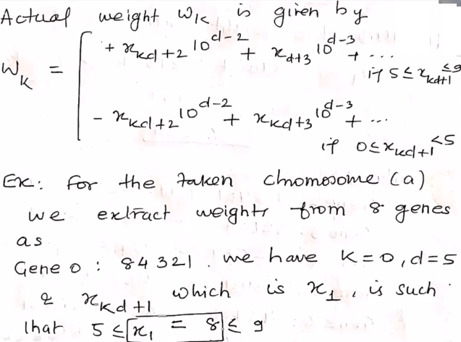

Slide 25
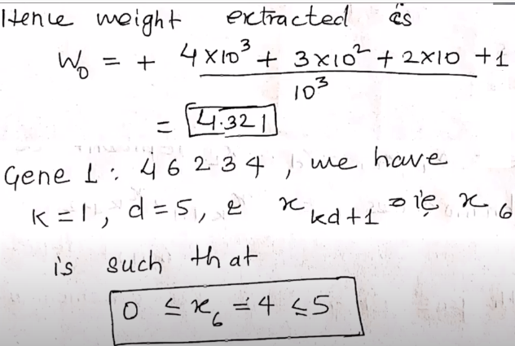

Slide 26
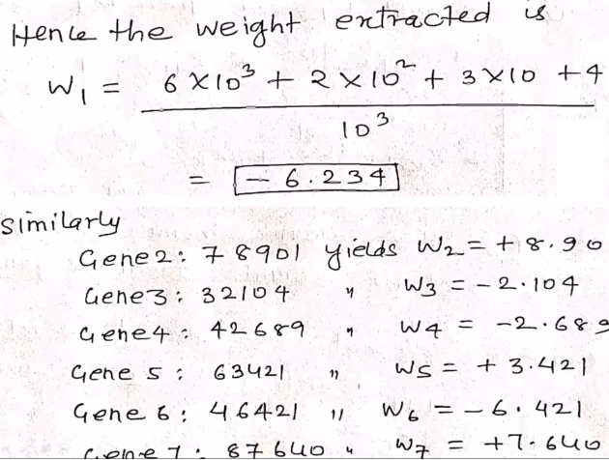

Slide 27
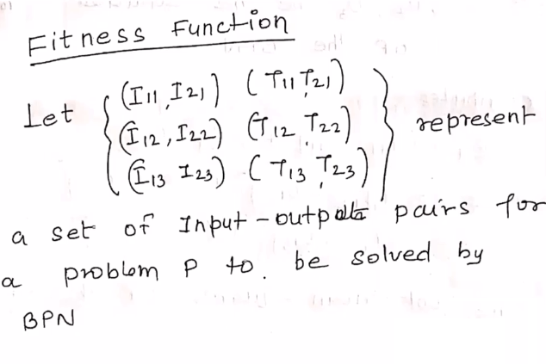

Slide 28
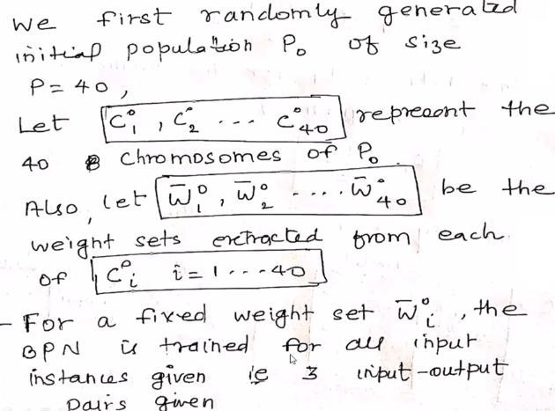

Slide 29
Advantages:
GAs are used to develop the best set of rules to be used by a fuzzy inference engine
GAs are used to optimize the choice of membership functions.
A Fuzzy GA is a directed random search over all discrete fuzzy subsets.
It can mimic human decision-making process.
Disadvantages:
Interpretation of results is difficult.
Difficult to build membership values and rules.
Takes lots of time to converge.
Applications:
Mechanical Engineering
Electrical Engine
Artificial Intelligence
Economics

Slide 30
SC – Hybrid Systems – Fuzzy BPN
3. Fuzzy Back Propagation Network
Neural Networks and Fuzzy logic (NN-FL) represents two distinct methodologies and the integration of NN and FL is called Neuro-Fuzzy systems.
Back Propagation Network (BPN) is a method of training multi-layer neural networks where learning occurs during this training phase.
RC Chakraborty, www.myreaders.info
Fuzzy-BPN architecture, maps fuzzy inputs to crisp outputs. Here, the Neurons uses LR-type fuzzy numbers.
The Fuzzy-Neuron structure, the architecture of fuzzy BP, its learning mechanism and algorithms are illustrated in next few slides.

Slide 31
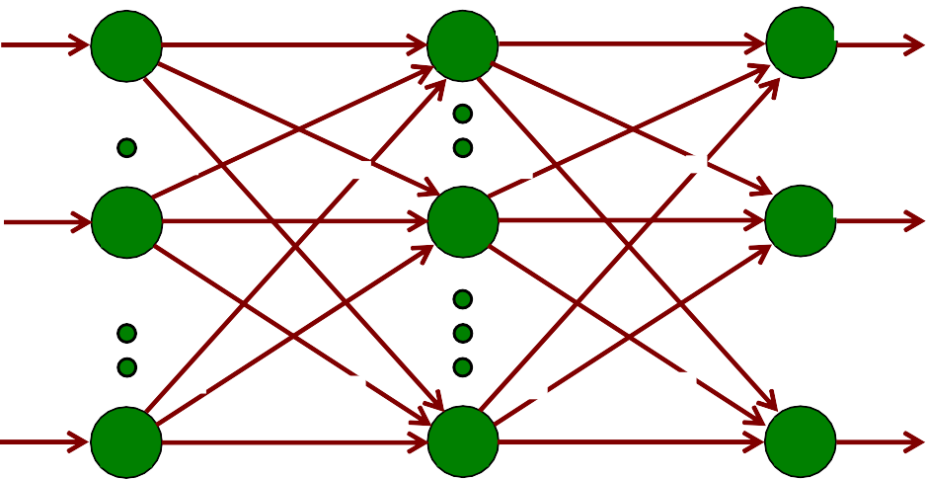
•
Architecture of Fuzzy BP
SC – Hybrid Systems – Fuzzy BPN
RC Chakraborty, www.myreaders.info
Fuzzy Back Propagation Network (BP) is a 3-layered feed forward architecture. The 3 layers are: input layer, hidden layer and output layer. Considering a configuration of ℓ-input neurons, m-hidden neurons and n-output neurons, the architecture of Fuzzy BP is shown below.
~
~
W O' V
_{I}"
"
Ip1
Op1
11 I'_{p1}
p1
11
p1
1
O p1
.
1 1
W1j
V1k
~
~
W
ij I'_{pj}
O'_{pj}
V
"
"
Ipi
i
Opj
j
jk
I pk
k
O pk
~
~
Ipℓ
ℓ
Opℓ
Wℓm
I'_{pm}
m
O'_{pm} ^{V}mn ^{I"}pn
n
O"pn
Fig.
Three layer Fuzzy BP architecture.
~
~
~ ~
Let
Ip =
,
, , . .
th
Ip1 Ip2 Ipℓ
,
for p = 1, 2, . . , N, be the p pattern
among N
input patterns that Fuzzy BP needs
to be trained.
~
_{i} th
Here, Ipi
indicates the component of input
pattern p and is an LR-
~ ~
~
~
type triangular fuzzy number, i.e.,
Ip =
,
, , . .
Ip1 Ip2 Ipβℓ
~
Let Opi
Let O'pj
th
be the output value of i input neuron.
and O'pk are j^{th} and k^{th} crisp defuzzification outputs of output layer neurons respectively.
the hidden and
Let Wij is the fuzzy connection weight between input node and
j^{th} hidden node.
_{i} th
_{j}th
Let Vjk is the fuzzy connection weight between hidden node and
_{k}th
output node.
[Continued in next slide]
31

Slide 32
SC – Hybrid Systems – Fuzzy BPN [ continued from previous slide – Architecture of Fuzzy BP]
The computations carried out by each layer are as follows: Input neurons:
~ ~
RC Chakraborty, www.myreaders.info
Opi Ipi
=
, i = 1 , 2 , . . . , ℓ .
Hidden neurons:
O' pj = f ( NET pj ) , i = 1 , 2 , . . . , m .
ℓ
where NET pj = C E ( Σ Wij O' pi )
i=0
Out neurons:
O" pk = f ( NET pk ) , i = 1 , 2 , . . . , n . ,
m
where
NET pk = C E ( Σ Vjk O' pj )
j=0
32

